Slide 1
Regular Expressions

Slide 2
Regular Expression
Regular expressions are an algebraic way to describe languages.
They describe exactly the regular languages.
If E is a regular expression, then L(E) is the language it defines.
Example:
describes the language

Slide 3
RE definition
Primitive regular expressions:
Given regular expressions r1 and r2:
Are regular expressions

Slide 4
RE Definition
For regular expressions r1 and r2

Slide 5
Some RE Examples
Regular Expressions | Regular Set
(0 + 10*) | L = { 0, 1, 10, 100, 1000, 10000, … }
(0*10*) | L = {1, 01, 10, 010, 0010, …}
(0 + ε)(1 + ε) | L = {ε, 0, 1, 01}
(a+b)* | Set of strings of a’s and b’s of any length including the null string. So L = { ε, a, b, aa , ab , bb , ba, aaa…….}
(a+b)*abb | Set of strings of a’s and b’s ending with the string abb. So L = {abb, aabb, babb, aaabb, ababb, …………..}
(11)* | Set consisting of even number of 1’s including empty string, So L= {ε, 11, 1111, 111111, ……….}
(aa)*(bb)*b | Set of strings consisting of even number of a’s followed by odd number of b’s , so L = {b, aab, aabbb, aabbbbb, aaaab, aaaabbb, …………..}
(aa + ab + ba + bb)* | String of a’s and b’s of even length can be obtained by concatenating any combination of the strings aa, ab, ba and bb including null, so L = {aa, ab, ba, bb, aaab, aaba, …………..}

Slide 6
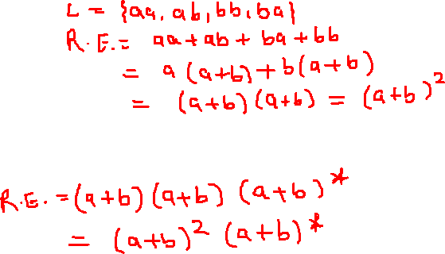
Questions
Write the R.E where input alphabet is {a,b} and the length of the string is exactly 2?
Write the R.E where input alphabet is {a,b} and the length of the string is at least 2?

Slide 7
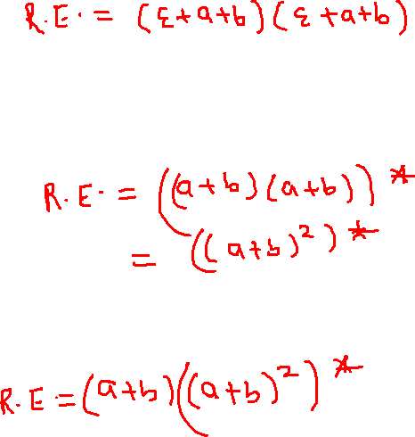
Write the R.E where input alphabet is {a,b} and the length of the string is at most 2?
Write the R.E where input alphabet is {a,b} and the length of the string is even?
Write the R.E where input alphabet is {a,b} and the length of the string is odd?

Slide 8



Write the R.E where input alphabet is {a, b} and the length of the string is divisible by 3?
Write the R.E where w={a, b} and |w| mod 3 =2?
Write the R.E where input alphabet is {a, b} and the number of a’s have to exactly 2?

Slide 9
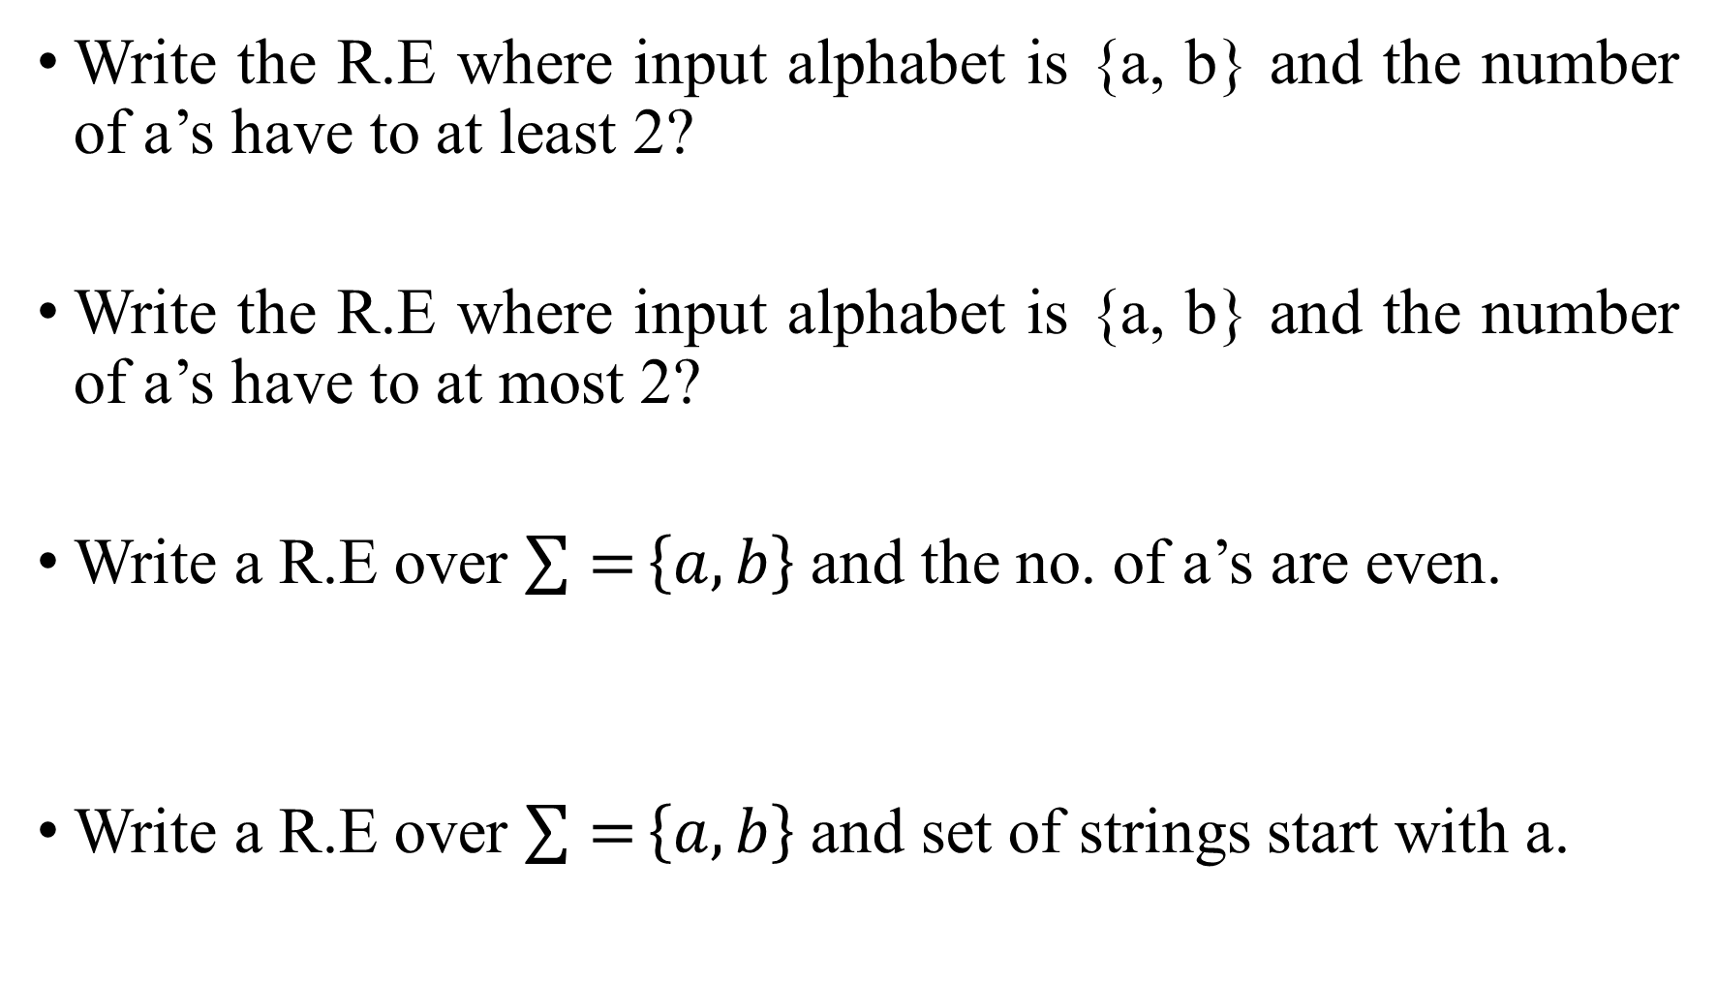

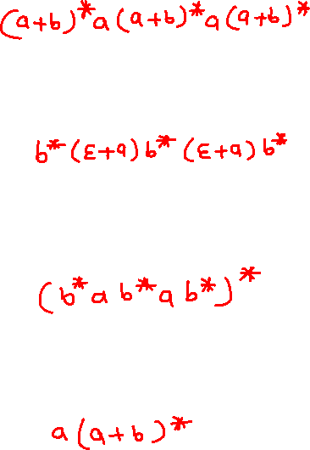
Write the R.E where input alphabet is {a, b} and the number of a’s have to at least 2?
Write the R.E where input alphabet is {a, b} and the number of a’s have to at most 2?
Write a R.E over $\sum{=}\left\{a,b\right\}$ and the no. of a’s are even.
Write a R.E over $\sum{=}\left\{a,b\right\}$ and set of strings start with a.

Slide 10
Regular Expression(RE)
Formally a regular expression is defined recursively as
Any terminal symbol (i.e. an element of ∑:), Ɛ and φ are regular expressions. When we view a in ∑ as a regular expression, we denote it by a.
The union of two regular expressions R1 and R2• written as R1+ R2, is also a regular expression.
The concatenation of two regular expressions R1 and R2, written as R1 R2, is also a regular expression.
The iteration (or closure) of a regular expression R written as R*, is also a regular expression.
If R is a regular expression, then (R) is also a regular expression.
The regular expressions over ∑ are precisely those obtained recursively by the application of the rules 1-5 once or several times.

Slide 11
Regular Expression(RE)
Basis 1: If a is any symbol, then a is a RE, and L(a) = {a}.
Note: {a} is the language containing one string, and that string is of length 1.
Basis 2: ε is a RE, and L(ε) = {ε}.
Basis 3: ∅ is a RE, and L(∅) = ∅.
Induction 1: If E₁ and E₂ are regular expressions, then E₁+E₂ is a regular expression, and L(E₁+E₂) = L(E₁)∪L(E₂).
Induction 2: If E₁ and E₂ are regular expressions, then E₁E₂ is a regular expression, and L(E₁E₂) = L(E₁)L(E₂).
Concatenation : the set of strings wx such that w
Is in L(E₁) and x is in L(E₂).

Slide 12
Regular Expression(RE)
Induction 3: If E is a RE, then E* is a RE, and L(E*) = (L(E))*.
Closure, or “Kleene closure” = set of strings
w₁w₂…w_{n}, for some n > 0, where each w_{i} is
in L(E).
Note: when n=0, the string is ε.
Precedence of Operators
Parentheses may be used wherever needed to influence the grouping of operators.
Order of precedence is * (highest), then concatenation, then + (lowest).

Slide 13
Given R, P, L, Q as regular expressions, the following identities hold −
∅* = ε
ε* = ε
RR* = R*R
R*R* = R*
(R*)* = R*
RR* = R*R
(PQ)*P =P(QP)*
(a+b)* = (a*b*)* = (a*+b*)* = (a+b*)* = a*(ba*)*
R + ∅ = ∅ + R = R (The identity for union)
R ε = ε R = R (The identity for concatenation)
∅ L = L ∅ = ∅ (The annihilator for concatenation)
R + R = R (Idempotent law)
L (M + N) = LM + LN (Left distributive law)
(M + N) L = ML + NL (Right distributive law)
ε + RR* = ε + R*R = R*

